Slide 1

Model to Predict Student Dropout and Academic Success
Team members- SAIBA SAIFI- 20CSE47 HARSHIT KUMAR- 20CSE22 ANUSHKA- 20CSE09 YASH VERMA- 20CSE69

Slide 2
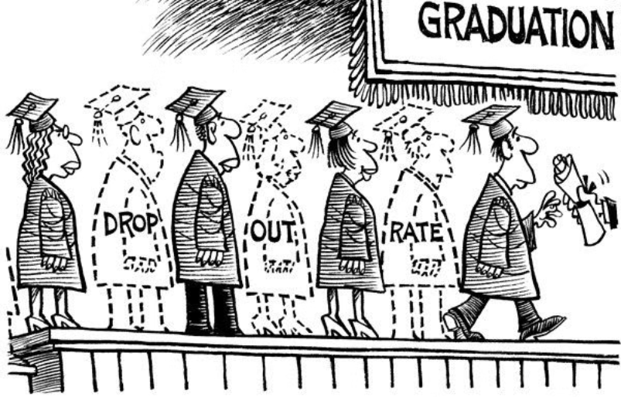
Introduction
The capacity to predict and proactively identify potential challenges faced by students is crucial for institutions seeking to develop strategies that support and guide those at risk of academic failure or dropout.

Slide 3
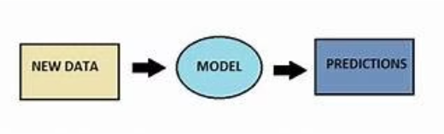


Objective
• To develop a predictive model that can effectively identify students at risk of dropping out or predict academic success.
• Aims to enhance educational outcomes by providing early intervention and support to students who may be facing challenges in their academic journey.

Slide 4
Dataset Used
The dataset comprises 50 entries, each delineating an individual student and encompassing 22 attributes.
Application mode
Age at enrollment
Gender
Tuition fees up to date
Scholarship holder
Nationality
Debtor
Course, etc.

Slide 5
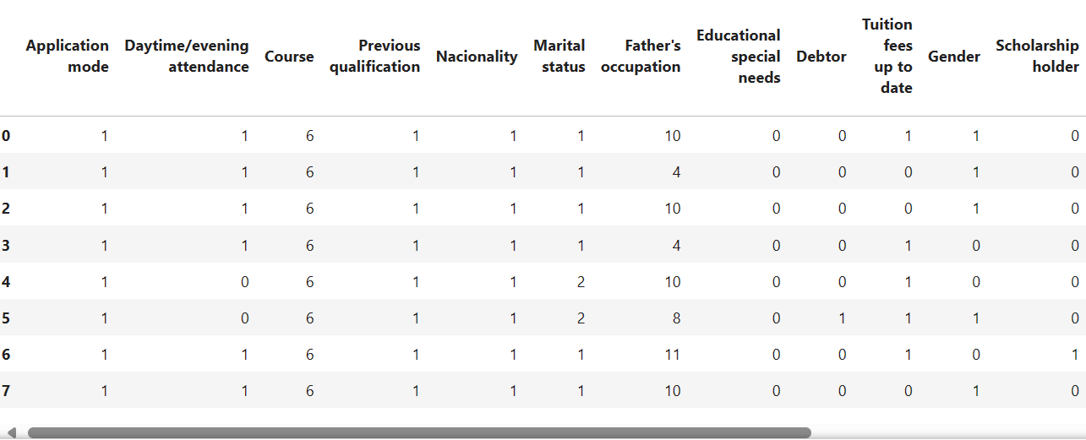
Dataset

Slide 6
Methology
Data Collection
1
2
Feature Selection
Data Preprocessing
3
4
Model Selection
Evaluation
5

Slide 7
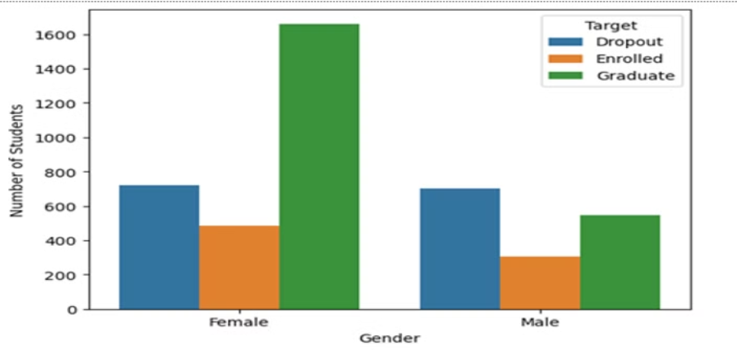
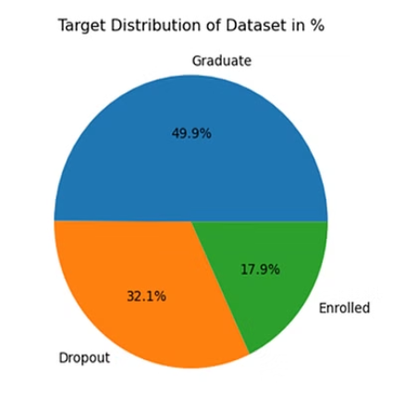
Dataset Analysis

Slide 8
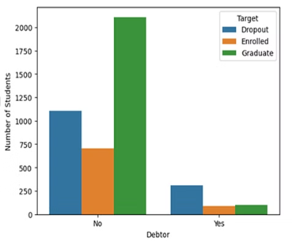
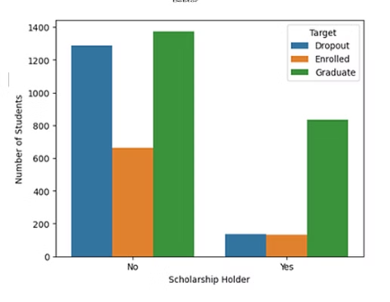
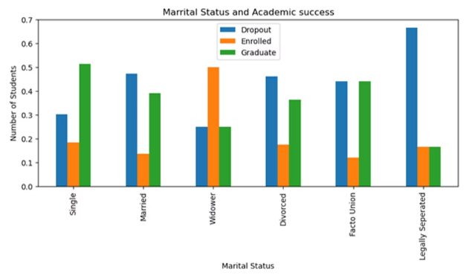

Slide 9
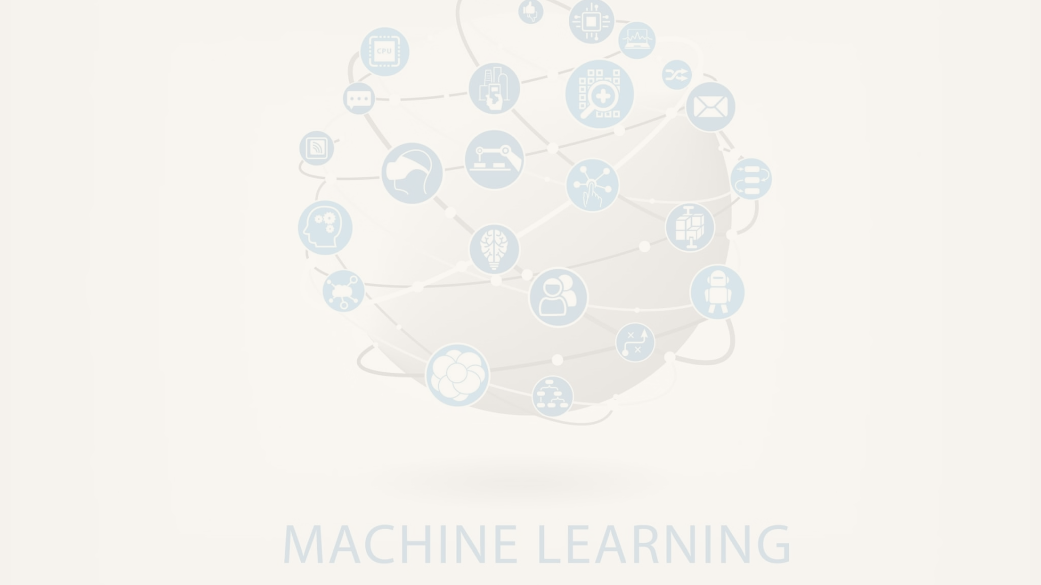
Building the Machine Learning Model
1
Logistic Regression
2
Decision Tree Classifier
3
Random Forest
4
K-NN
5
XG-Boost

Slide 10
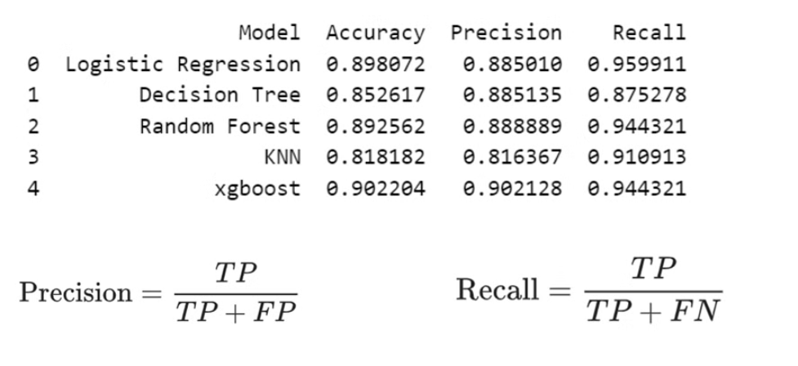
Results and Performance Metrics
The model's predictions, along with its accuracy, precision, and recall are
analyzed.

Slide 11



Potential Applications and Future Work
The model's insights enable the implementation of interventions, personalized learning, and targeted support to reduce dropout rates and improve student success. Future work involves expanding the model's scope and enhancing predictive accuracy.
Early Interventions
Personalized Learning
Model Expansion

Slide 12


Conclusion and Key Takeaways
The XGBoost Algorithm yielded the most favorable outcomes, excelling in both recall and accuracy.
Insightful Predictions
1
Providing actionable information
for student support.
Enhanced Interventions
2
Enabling targeted strategies to improve student outcomes.

Slide 13


